Slide 1
Ranger 3.0 Troubleshooter
Camera Related Error
Available Version
Ver 1.0

Slide 2
Ranger 3.0 Troubleshooter
Camera Related Error (DM not found Error)
Ver.1.0
Start
Note:
Run the slide and click on buttons, videos or hyperlinks as necessary. DO NOT USE ARROW KEYS
In case of incorrect selection, rerun the slide or go to previous slide
FlowChart Reference

Slide 3
Ranger 3.0 Troubleshooter
Error Description:
Follow this page if following is happened in BoT
Ranger is not able to decode Either Top or Bottom barcode .
Ranger is showing DM not found error in logs while operation.
Next

Slide 4
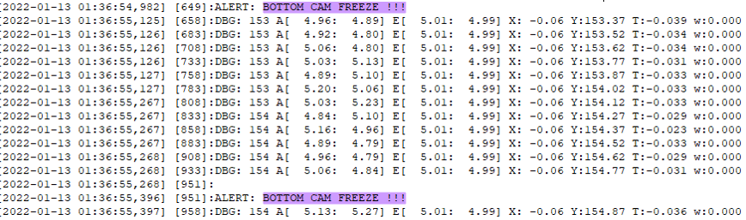
Ranger GTP 3.0 Troubleshooter
Check the Camera Freeze or camera disconnection related error in navigation logs as mentioned in support link document.
SN | Support Links
1 | Procedure to Check Nav Log
Did we receive the Camera Freeze issue in nav log?
YES
NO
Back
Next

Slide 5
Ranger GTP 3.0 Troubleshooter
Click on relevant Key for resolving the issue-
Probable Root Cause 1 for Nav issue
Probable Root Check for IMU issue
Top/ Bottom DM NOT FOUND
Probable Root Check for IPU issue

Slide 6
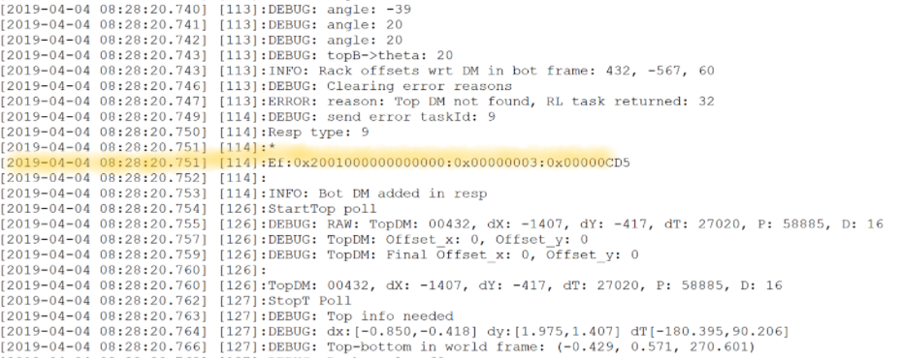
Ranger 3.0 Troubleshooter
Check the dx value reported before and after DM not found error as mentioned in support link document.
SN | Support Links
1 | Procedure to Check dx value in Nav Log
Next
Back

Slide 7
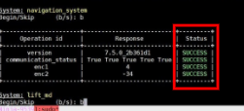
Ranger 3.0 Troubleshooter
Perform Nav diagnostic as mentioned in support link document.
SN | Support Links
1 | Procedure to Perform Navigation Diagnostic
Next
Back

Slide 8
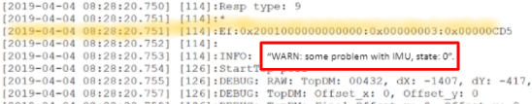
Ranger 3.0 Troubleshooter
Check IMU and NAV not communicating or is "WARN: some problem with IMU, state: 0" printed in NAV logs as mentioned in support link document.
SN | Support Links
1 | Procedure to Check Error in Nav Log
Did IMU error receive in nav log?
YES
NO
Back

Slide 9
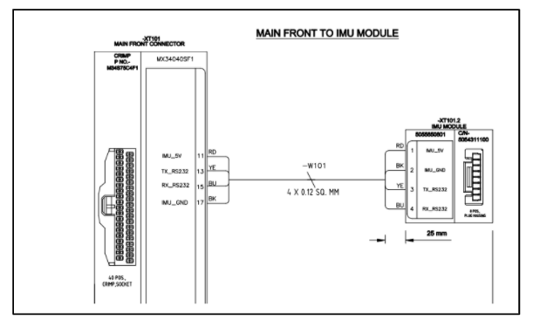
Ranger 3.0 Troubleshooter
Check IMU related harness as mentioned in support link document.
Again perform the diagnostic as mentioned in support link document.
SN | Support Links
1 | Procedure to Check IMU Related Harness Procedure to Perform Navigation Diagnostic
Did issue get resolved?
YES
NO
Back

Slide 10
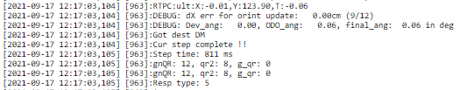
Ranger 3.0 Troubleshooter
Find the "RTPC:ult:X:" in NAV logs after DM not found as mentioned in support link document.
Check the ABS (X) value in nav log.
SN | Support Links
1 | Procedure to Check RTPC : ult:X:
Did ABS (X) >=4.8 cm?
YES
NO
Back

Slide 11
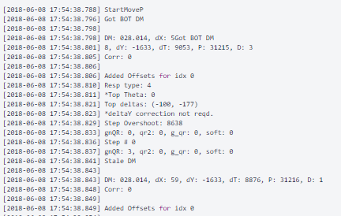
Ranger 3.0 Troubleshooter
Check the ABS (Theeta) value or camera theta mounting error as mentioned in support link document.
SN | Support Links
1 | Procedure To Check ABS (Theeta) Value
Did ABS(Theta) >= 5 degree ?
YES
NO
Back

Slide 12
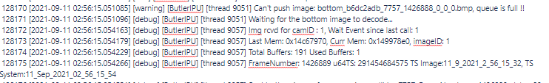
Ranger 3.0 Troubleshooter
Check the IPU log as mentioned in support link document.
SN | Support Links
1 | Procedure To Check IPU Log
is "Img rcvd for camID : 1" printed in IPU Logs?
YES
NO
Back

Slide 13
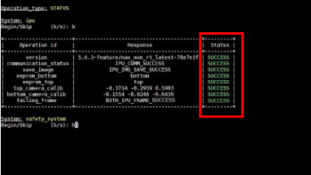
Ranger 3.0 Troubleshooter
If "Img rcvd for camID : 1" is printed in IPU Logs, it means image are being received by the IPU.
Put the Ranger on barcode and perform IPU diagnostic as mentioned in support link document.
SN | Support Links
1 | Procedure To Perform IPU Diagnostics
Did diagnostic test Pass?
YES
NO
Back

Slide 14
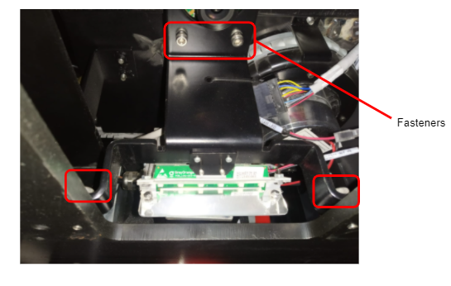
Ranger 3.0 Troubleshooter
Check camera mounting issue as mentioned in support link document .
Restart the bot and check if the issue is resolved.
SN | Support Links
1 | Procedure To Check Camera Mounting Issue
Is your error fixed?
YES
NO
Back

Slide 15
Ranger 3.0 Troubleshooter
Check camera mounting issue as mentioned in support link document .
Restart the bot and check if the issue is resolved.
SN | Support Links
1 | Procedure To Check Camera Mounting Issue
Is your error fixed?
YES
NO
Back

Slide 16
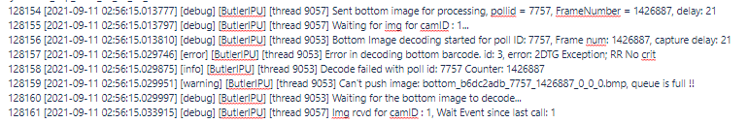
Ranger 3.0 Troubleshooter
Check "Error in decoding bottom barcode. id: x, error: 2DTG Exception; y" printed in IPU logs as mentioned in support link document .
SN | Support Links
1 | Procedure To Check Error in IPU Log
Is "Error in decoding bottom barcode. id: x, error: 2DTG Exception; y" printed in IPU logs
YES
NO
Back

Slide 17
Ranger 3.0 Troubleshooter
Find the latest image in /data/fw/ipu/diag/ folder as mentioned in support link document .
SN | Support Links
1 | Procedure To Check Latest Image
Next
Back

Slide 18
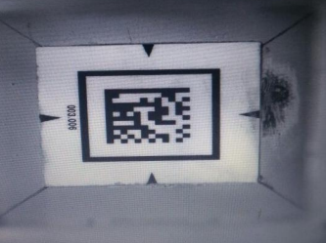
Ranger 3.0 Troubleshooter
Check barcode quality . If barcode is damage, Replace the barcode as mentioned in support link document.
Again restart the Ranger and check if the issue is resolved.
SN | Support Links
1 | Procedure To Replace Barcode
Is your error fixed?
YES
NO
Back

Slide 19
Ranger 3.0 Troubleshooter
Check image illumination as mentioned in support link document .
SN | Support Links
1 | Procedure To Check Image Illumination
Next
Back

Slide 20

Ranger 3.0 Troubleshooter
Find the latest print of "Quality symbol_contrast : x" in IPU logs as mentioned in support link document .
SN | Support Links
1 | Procedure To Check Error in IPU Log
Is symbol_contrast < 38?
YES
NO
Back

Slide 21
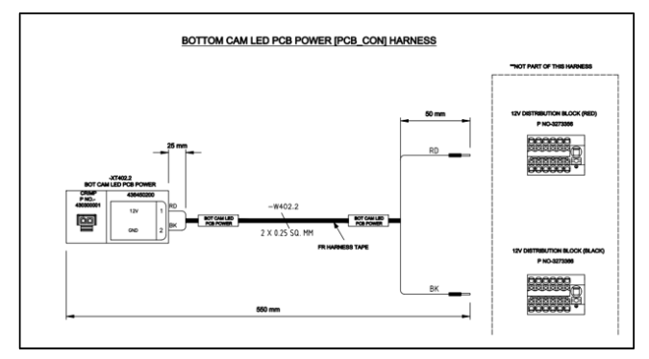
Ranger 3.0 Troubleshooter
Check camera power harness to camera led PCB as mentioned in support link document .
SN | Support Links
1 | Procedure To Check Camera Power Harness to CAM Led PCBA
Next
Back
Next

Slide 22
Ranger 3.0 Troubleshooter
Perform IPU diagnostic as mentioned in support link document .
SN | Support Links
1 | Procedure To Perform IPU Diagnostic
Did diagnostic test Pass?
YES
NO
Back
Next

Slide 23
Ranger 3.0 Troubleshooter
Replace the Camera Led PCBA.
Perform IPU diagnostic as mentioned in support link document .
SN | Support Links
1 | Procedure To Perform IPU Diagnostic
Did diagnostic test Pass?
YES
NO
Back
Next

Slide 24
Ranger 3.0 Troubleshooter
Update the IPU and Diagnostics to latest available version.
Restart the Ranger and check if issue is resolved.
Note: Contact server team for this IPU and diagnostic file deployment.
Is your error fixed?
YES
NO
Back
Next

Slide 25
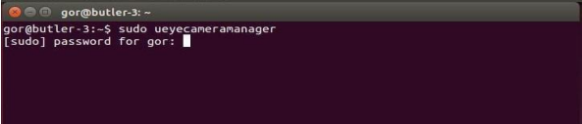
Ranger 3.0 Troubleshooter
Check camera focusing as mentioned in support link document.
Perform IPU diagnostics and check if the issue is resolved.
SN | Support Links
1 | Procedure To Camera Focusing
Is your error fixed?
YES
NO
Back
Next

Slide 26
Ranger 3.0 Troubleshooter
Perform IPU diagnostic as mentioned in support link document .
SN | Support Links
1 | Procedure To Perform IPU Diagnostic
Did diagnostic test Pass?
YES
NO
Back
Next

Slide 27
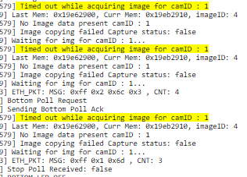
Ranger 3.0 Troubleshooter
Check "Timed out while acquiring image for camID : 1" printed in IPU Logs as mentioned in support link document.
SN | Support Links
1 | Procedure To Check Error From IPU Log
Is "Timed out while acquiring image for camID : 1" printed in IPU Logs?
YES
NO
Back
Next

Slide 28
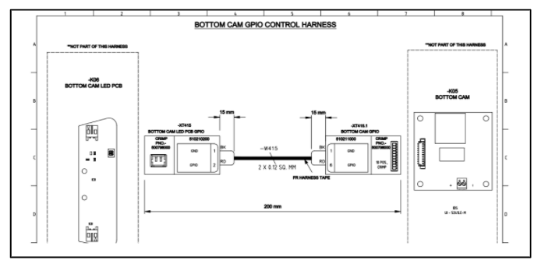
Ranger 3.0 Troubleshooter
Check camera related harness as mentioned in support link document.
Restart the bot and again check if the issue is resolved.
SN | Support Links
1 | Procedure To Check Camera Related Harness
Is your error fixed?
YES
NO
Back
Next

Slide 29

Ranger 3.0 Troubleshooter
Check if "Alert, Bottom CAM Freeze!!!, or ‘Alert Bottom CAM Disconnected’ printed in IPU logs as mentioned in support link document.
SN | Support Links
1 | Procedure To Check Error in IPU Log
Is bottom CAM Freeze printed in IPU logs?
YES
NO
Back
Next

Slide 30
Ranger 3.0 Troubleshooter
Is "Camera Freezed for camID x" printed in IPU logs as mentioned in support link document.
SN | Support Links
1 | Procedure To Check Error in IPU Log
Is "Camera Freezed for camID x" printed in IPU logs?
YES
NO
Back
Next

Slide 31

Ranger 3.0 Troubleshooter
Open /var/log/syslog file at the same timestamp as mentioned in support link document.
SN | Support Links
1 | Procedure To Check Sys Log
is "eqos 2490000.ether_qos eth0: Link is Down" printed in syslog?
YES
NO
Back
Next

Slide 32
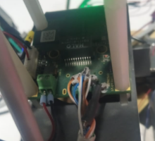
Ranger 3.0 Troubleshooter
Check for Ethernet wire soldering on camera PCB as mentioned in support link document.
If ethernet wire is not proper soldering, solder it again.
Restart the Ranger and check if the issue is resolved.
SN | Support Links
1 | Procedure To Check Ethernet Wire Soldering
Is your error fixed?
YES
NO
Back
Next

Slide 33
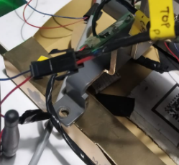
Ranger 3.0 Troubleshooter
Check if 12V supply harness of Camera is loose as mentioned in support link document.
Restart the Ranger and check if the issue is resolved.
SN | Support Links
1 | Procedure To Check 12V Supply Harness of Camera
Is your error fixed?
YES
NO
Back
Next

Slide 34
Ranger 3.0 Troubleshooter
Again perform IPU diagnostic and check if the issue is resolved as mentioned in support link document.
SN | Support Links
1 | Procedure To Perform IPU Diagnostics
Is your issue fixed?
YES
NO
Back
Next

Slide 35
Ranger 3.0 Troubleshooter
Replace camera unit if CAM_FREEZE issue persist as mentioned in support link document.
SN | Support Links
1 | Procedure To Replace Camera Assembly
Next
Back
Next

Slide 36
Ranger 3.0 Troubleshooter
If the X value is close to or more than +/-5cm then there is no decoding issue with the camera.
Next
Back
Next

Slide 37
Ranger 3.0 Troubleshooter
Bot probably missed the barcode because barcode was not in the camera view.
Next
Back
Next

Slide 38
Ranger 3.0 Troubleshooter
Now Nav related issue debugged so now go to next root cause. Click on Next button.
Next
Back
Next

Slide 39
Ranger 3.0 Troubleshooter
If we do not get any DM not found related issue in nav log, it means this is not camera related issue.
Done
Back
Next

Slide 40
Ranger 3.0 Troubleshooter
If previous steps could not resolve the issue, create a site support ticket for resolution of error.
Done
Back
Next

Slide 41
Ranger 3.0 Troubleshooter
END OF TROUBLESHOOT
Begin Again

